Slide 1
Mathematics for Analytics and Finance
Sami Najafi
MSIS2402/2502
Module 3

Slide 2
Matrix Algebra

Slide 3
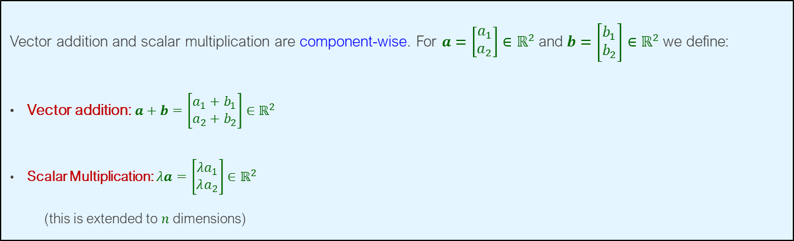
Vectors
Definition: A vector, in simple terms, is like a list of numbers arranged either in a single column or a single row.
Example: $a=\left[\begin{aligned}a_{1} \\ a_{2}\end{aligned}\right]$, $a_{1}=$ number of products 1, $a_{2}=$ number of products 2
Vector addition and scalar multiplication are component-wise. For $a=\left[\begin{aligned}a_{1} \\ a_{2}\end{aligned}\right]∈ℝ^{2}$and $b=\left[\begin{aligned}b_{1} \\ b_{2}\end{aligned}\right]∈ℝ^{2}$we define:
Vector addition: $a+b=\left[\begin{aligned}a_{1}+b_{1} \\ a_{2}+b_{2}\end{aligned}\right]∈ℝ^{2}$
Scalar Multiplication: $λa=\left[\begin{aligned}{λa}_{1} \\ λa_{2}\end{aligned}\right]∈ℝ^{2}$
(this is extended to $n$ dimensions)
Remark: $a=\left[\begin{aligned}1 \\ 2 \\ 3\end{aligned}\right]$ is also written as $a=(1,2,3)$

Slide 4
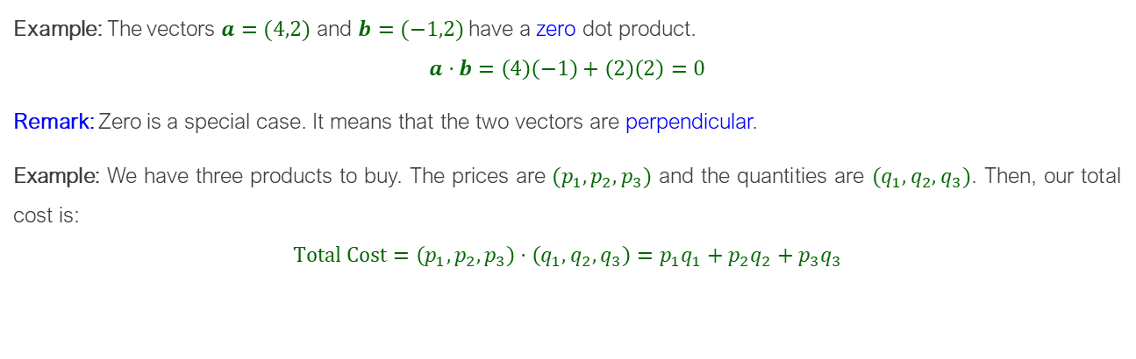
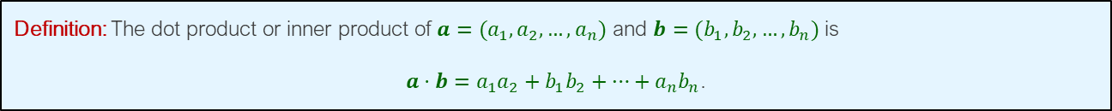
Dot Products
Definition: The dot product or inner product of $a=(a_{1},a_{2},…,a_{n})$ and $b=(b_{1},b_{2},…,b_{n})$ is
$a⋅b=a_{1}a_{2}+b_{1}b_{2}+…+a_{n}b_{n}$.
Example: The vectors $a=(4,2)$ and $b=(−1,2)$ have a zero dot product.
$$a⋅b=\left(4\right)\left(−1\right)+\left(2\right)\left(2\right)=0$$
Remark: Zero is a special case. It means that the two vectors are perpendicular.
Example: We have three products to buy. The prices are $(p_{1},p_{2},p_{3})$ and the quantities are $(q_{1},q_{2},q_{3})$. Then, our total cost is:
$$Total Cost=\left(p_{1},p_{2},p_{3}\right)⋅\left(q_{1},q_{2},q_{3}\right)=p_{1}q_{1}+p_{2}q_{2}+p_{3}q_{3}$$

Slide 5
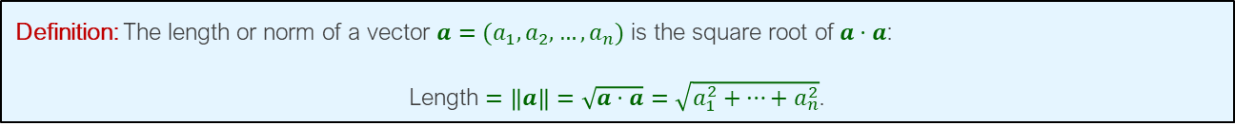
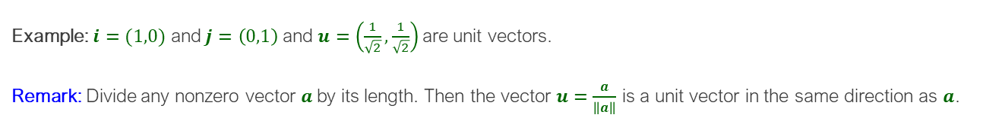
Length and Unit Vectors
Definition: The length or norm of a vector $a=(a_{1},a_{2},…,a_{n})$ is the square root of $a⋅a$:
Length $=\left\|a\right\|=\sqrt{a⋅a}=\sqrt{a_{1}^{2}+…+a_{n}^{2}}$.
Example: The length of $a=(3, 4)$ is $\sqrt{3^{2}+4^{2}}=5$
Definition: A unit vector $u$is a vector whose length is equal to one. That is, $u⋅u=1$
Example: $i=(1,0)$ and $j=\left(0,1\right)$ and $u=\left(\frac{1}{\sqrt{2}},\frac{1}{\sqrt{2}}\right)$ are unit vectors.
Remark: Divide any nonzero vector $a$by its length. Then the vector $u=\frac{a}{\left\|a\right\|}$ is a unit vector in the same direction as $a$.

Slide 6
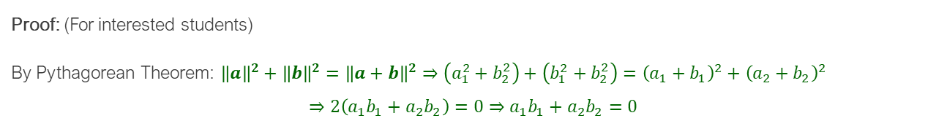



Angle between Two Vectors
If $a$ is perpendicular to $b$, then $a⋅b=0$.
Proof: (For interested students)
By Pythagorean Theorem: ${\left\|a\right\|}^{2}+{\left\|b\right\|}^{2}={\left\|a+b\right\|}^{2}⇒\left(a_{1}^{2}+b_{2}^{2}\right)+\left(b_{1}^{2}+b_{2}^{2}\right)={\left(a_{1}+b_{1}\right)}^{2}+{\left(a_{2}+b_{2}\right)}^{2}$
$$⇒2\left(a_{1}b_{1}+a_{2}b_{2}\right)=0⇒a_{1}b_{1}+a_{2}b_{2}=0$$
$$b$$
$$a$$
$$a+b$$

Slide 7
Vectors in R
Creating and Combining Vectors
c(first number or string,…,last number or character)
> c(1,1,2,3,5,8,13,21)
[1] 1 1 2 3 5 8 13 21
> c(1*pi, 2*pi, 3*pi, 4*pi)
[1] 3.141593 6.283185 9.424778 12.566371
> c("Everyone", "loves", "stats.")
[1] "Everyone" "loves" "stats."
Combining two vectors:
> v1 = c(1,2,3)
> v2 = c(4,5,6)
> c(v1,v2)
[1] 1 2 3 4 5 6

Slide 8
Vectors in R
Computing Basic Statistics
mean(x), median(x), sd(x) var(x), cor(x,y), cov(x,y), range(x), quantile(x)
summary(x) gives some of the summary statistics
> x = c(0,1,1,2,3,5,8,13,21,34)
> y = log(x+1)
> mean(x)
[1] 8.8
> median(x)
[1] 4
> sd(x)
[1] 11.03328
> summary(x)
Min. 1st Qu. Median Mean 3rd Qu. Max.
0.00 1.25 4.00 8.80 11.75 34.00

Slide 9
Vectors in R
Creating Sequences
seq(from, to) or from:to
seq(from, to, by= )
seq(from, to, length= )
rep(number, number of repetitions)
> 10:19
[1] 10 11 12 13 14 15 16 17 18 19
> 9:0
[1] 9 8 7 6 5 4 3 2 1 0
> seq(from=0, to=20)
[1] 0 1 2 3 4 5 6 7 8 9 10 11 12 13 14 15 16 17 18 19 20
> seq(from=0, to=20, by=2)
[1] 0 2 4 6 8 10 12 14 16 18 20
> seq(from=1.0, to=2.0, length=5)
[1] 1.00 1.25 1.50 1.75 2.00

Slide 10
Vectors in R
Comparing Numbers and Vectors
The comparison operators compare two values and return TRUE or FALSE.
For two vectors, the comparison is component-wise. The result is a logical vector.
> a = 3
> a == pi
[1] FALSE
> a != pi
[1] TRUE
> a < pi
[1] TRUE
> v = c( 3, pi, 4)
> w = c(pi, pi, pi)
> v == w
[1] FALSE TRUE FALSE

Slide 11
Vectors in R
Comparing Numbers and Vectors
any(v == w) Return TRUE if any element of v equals the same element in w
all(v == w) Return TRUE if all element of v equals the same element in w
any(v == num) Return TRUE if any element of v equals the value num
all(v == num) Return TRUE if all element of v equals the value num
> v = c(3,pi,4)
> w = c(pi,pi,pi)
> v != w
[1] TRUE FALSE TRUE
> v <= w
[1] TRUE TRUE FALSE
> v != 3
[1] FALSE TRUE TRUE
> any(v != 3)
[1] TRUE

Slide 12
Vectors in R
Choosing Vector Elements
vec[a] Select element a
vec[a:b] Select elements a through b
vec(c(a,b,c)) Select elements a,b, and c.
vec(-a:-b) or vec(-(a:b)) exclude elements a through b
> fib = c(0,1,1,2,3,5,8,13,21,34)
> fib[6]
[1] 05
> fib[4:9]
[1] 2 3 5 8 13 21
> fib[c(1,2,4,8)]
[1] 0 1 2 13
> fib[-1:-5]
[1] 5 8 13 21 34

Slide 13
Vectors in R
More Complex Element Selections
Vec[vec<=a] Select elements that are not greater than a
Vec[vec>=a&vec<=b] Select elements that are between a and b inclusively
More complex element selections can be coded similarly.
> fib = c(0,1,1,2,3,5,8,13,21,34)
> fib[fib < 10] # Use that vector to select elements less than 10
[1] 0 1 1 2 3 5 8
> fib[fib > mean(fib)] # Use that vector to select elements less than 10
[1] 13 21 34
> fib[fib<=5|fib>=21] # | means “or”
[1] 0 1 1 2 3 5 21 34
> fib[fib>5&fib<21] # | means “and”
[1] 8 13
> w=c(1,2,4,3,5,6,8,2,7,0)
> fib[w>5]
[1] 5 8 21

Slide 14
Vectors in R
Arithmetic Operations
+, -, *, /, ^: These arithmetic operations are component-wise
> v = c(11,12,13,14,15)
> w = c(1,2,3,4,5)
> v + w
[1] 12 14 16 18 20
> v - w
[1] 10 10 10 10 10
> v * w
[1] 11 24 39 56 75
> v / w
[1] 11.000000 6.000000 4.333333 3.500000 3.000000
> w ^ v
[1] 1 4096 1594323 268435456 30517578125

Slide 15
Vectors in R
Arithmetic Operations between a Vector and a Scalar
The operation is performed between every vector element and the scalar
> w + 2
[1] 3 4 5 6 7
> w - 2
[1] -1 0 1 2 3
> w * 2
[1] 2 4 6 8 10
> w / 2
[1] 0.5 1.0 1.5 2.0 2.5
> w ^ 2
[1] 1 4 9 16 25
> 2 ^ w
[1] 2 4 8 16 32

Slide 16
Vectors in R
Operation of Functions on Vectors
Functions operate on every element. The result is a vector.
> w
[1] 1 2 3 4 5
> sqrt(w)
[1] 1.000000 1.414214 1.732051 2.000000 2.236068
> log(w)
[1] 0.0000000 0.6931472 1.0986123 1.3862944 1.6094379
> sin(w)
[1] 0.8414710 0.9092974 0.1411200 -0.7568025 -0.9589243

Slide 17
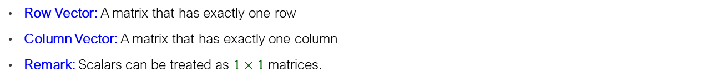
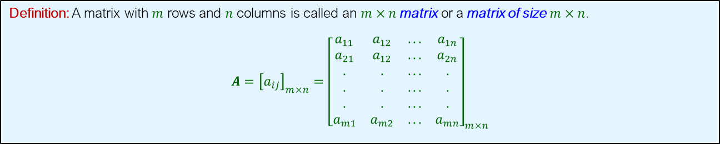
Matrices
Definition: A matrix with $m$ rows and $n$ columns is called an $m×n$ matrix or a matrix of size $m×n$.
$${A={\left[a_{ij}\right]}_{m×n}=\left[\begin{matrix}a_{11} & a_{12} & ... & a_{1n} \\ a_{21} & a_{12} & ... & a_{2n} \\ . & . & ... & . \\ . & . & ... & . \\ . & . & ... & . \\ a_{m1} & a_{m2} & ... & a_{mn}\end{matrix}\right]}_{m×n}$$
Row Vector: A matrix that has exactly one row
Column Vector: A matrix that has exactly one column
Remark: Scalars can be treated as $1×1$ matrices.
Equal Matrices: $\text{For} A=[a_{ij}]_{m×n} \text{and} B=[b_{ij}]_{m×n}$
$$A=B \text{if} \text{and} \text{only} \text{if} a_{ij}=b_{ij} \text{for} \text{all} 1≤i≤m,1≤j≤n$$

Slide 18
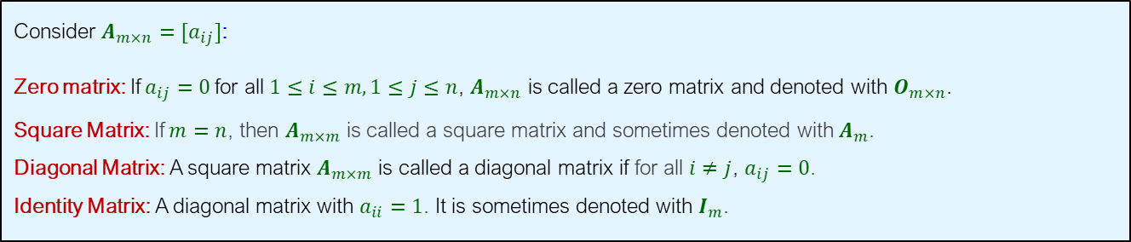
Special Matrices
Consider $A_{m×n}=[a_{ij}]$:
Zero matrix: If $a_{ij}=0$for all $1≤i≤m, 1≤j≤n$, $A_{m×n}$ is called a zero matrix and denoted with $O_{m×n}$.
Square Matrix: If $m=n$, then $A_{m×m}$ is called a square matrix and sometimes denoted with $A_{m}$.
Diagonal Matrix: A square matrix $A_{m×m}$ is called a diagonal matrix if for all $i≠j$, $a_{ij}=0$.
Identity Matrix: A diagonal matrix with $a_{ii}=1$. It is sometimes denoted with $I_{m}$.

Slide 19
Matrices in R
Creating a Matrix
Mat=matrix(c(a1,…,an),nrow=,ncol=,byrow=)
dim(Mat) gives the matrix dimension
> mat=matrix(c(1,2,3,4),2,2,byrow=1)
> mat
[,1] [,2]
[1,] 1 2
[2,] 3 4
Zero Matrix: z= matrix(0,nrow=,ncol=)
> matrix(0, ncol = 4, nrow = 6)
Diagonal Matrix: d=diag(c(a1,…,an))
> diag(c(1,4,6))
Identity Matrix: I=diag(n)
> diag(3)

Slide 20
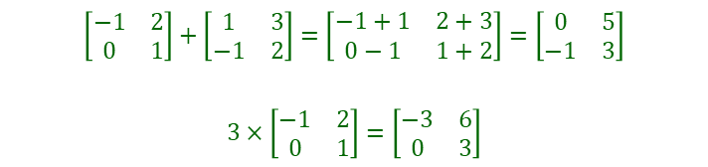
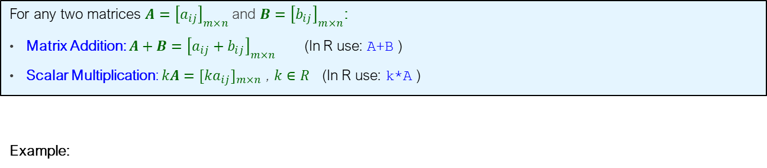
Matrix Addition and Scalar Multiplication
For any two matrices $A={\left[a_{ij}\right]}_{m×n}$and $B={\left[b_{ij}\right]}_{m×n}$:
Matrix Addition: $A+B={\left[a_{ij}+b_{ij}\right]}_{m×n}$ (In R use: A+B )
Scalar Multiplication: $kA=[ka_{ij}]_{m×n}$ , $k∈R$ (In R use: k*A )
Example:
$$\left[\begin{matrix}−1 & 2 \\ 0 & 1\end{matrix}\right]+\left[\begin{matrix}1 & 3 \\ −1 & 2\end{matrix}\right]=\left[\begin{matrix}−1+1 & 2+3 \\ 0−1 & 1+2\end{matrix}\right]=\left[\begin{matrix}0 & 5 \\ −1 & 3\end{matrix}\right]$$
$$3×\left[\begin{matrix}−1 & 2 \\ 0 & 1\end{matrix}\right]=\left[\begin{matrix}−3 & 6 \\ 0 & 3\end{matrix}\right]$$

Slide 21
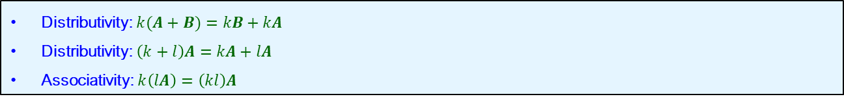
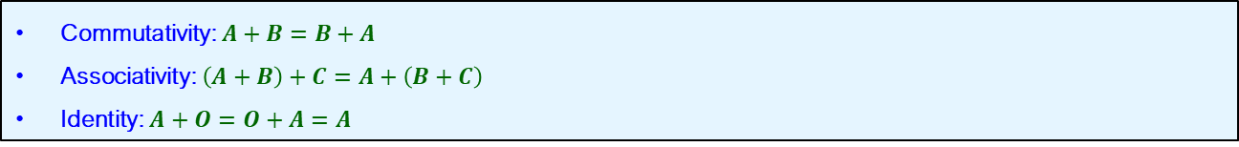
Matrix Addition and Scalar Multiplication
Properties
Matrix Addition:
Commutativity: $A+B=B+A$
Associativity: $\left(A+B\right)+C=A+\left(B+C\right)$
Identity: $A+O=O+A=A$
Scalar Multiplication:
Distributivity: $k(A+B)=kB+kA$
Distributivity: $\left(k+l\right)A=kA+lA$
Associativity: $k\left(lA\right)=\left(kl\right)A$
Remark: $A−B=A+\left(−1\right)B={\left[a_{ij}−b_{ij}\right]}_{m×n}$

Slide 22
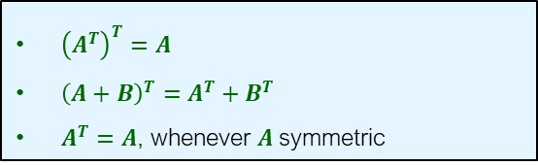
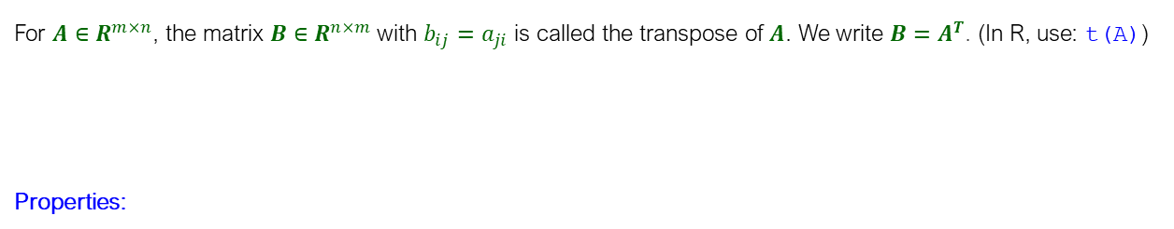
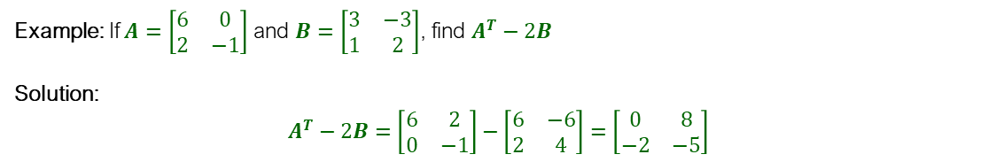

Transpose of A Matrix
For $A∈R^{m×n}$, the matrix $B∈R^{n×m}$with $b_{ij}=a_{ji}$ is called the transpose of $A$. We write $B=A^{T}$. (In R, use: t(A))
Properties:
Example:
$A=\left[\begin{matrix}1 & 2 & 3 \\ 4 & 5 & 6\end{matrix}\right]$⇒$A^{T}=\left[\begin{matrix}1 & 4 \\ 2 & 5 \\ 3 & 6\end{matrix}\right]$
${\left(A^{T}\right)}^{T}=A$
${\left(A+B\right)}^{T}=A^{T}+B^{T}$
$A^{T}=A$, whenever $A$ symmetric
Example: If $A=\left[\begin{matrix}6 & 0 \\ 2 & −1\end{matrix}\right]$ and $B=\left[\begin{matrix}3 & −3 \\ 1 & 2\end{matrix}\right]$, find $A^{T}−2B$
Solution:
$$A^{T}−2B=\left[\begin{matrix}6 & 2 \\ 0 & −1\end{matrix}\right]−\left[\begin{matrix}6 & −6 \\ 2 & 4\end{matrix}\right]=\left[\begin{matrix}0 & 8 \\ −2 & −5\end{matrix}\right]$$

Slide 23
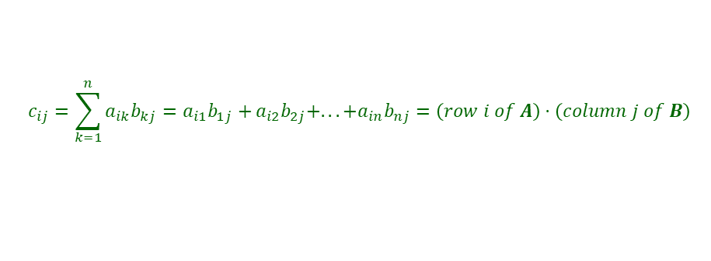
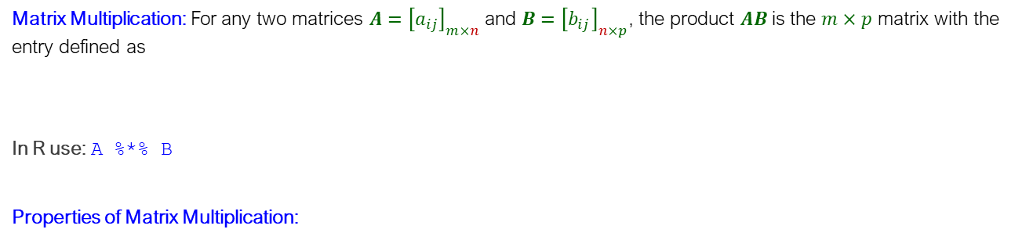
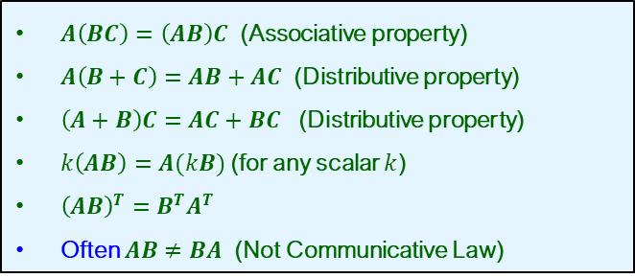
Matrix Multiplication
Matrix Multiplication: For any two matrices $A={\left[a_{ij}\right]}_{m×n}$and $B={\left[b_{ij}\right]}_{n×p}$, the product $AB$is the $m×p$ matrix with the entry defined as
In R use: A %*% B
Properties of Matrix Multiplication:
$$c_{ij}=\sum_{k=1}^{n}{a_{ik}b_{kj}=a_{i1}b_{1j}+}a_{i2}b_{2j}+...+a_{in}b_{nj}=\left(row i of A\right)⋅\left(column j of B\right)$$
$A\left(BC\right)=\left(AB\right)C$ (Associative property)
$A\left(B+C\right)=AB+AC$ (Distributive property)
$\left(A+B\right)C=AC+BC$ (Distributive property)
$k\left(AB\right)=A(kB)$ (for any scalar $k$)
${\left(AB\right)}^{T}=B^{T}A^{T}$
Often $AB≠BA$ (Not Communicative Law)

Slide 24

Example
Matrix Multiplication
a. $\left[\begin{matrix}1 & 2 & 3\end{matrix}\right]\left[\begin{matrix}4 \\ 5 \\ 6\end{matrix}\right]=$
b. $\left[\begin{matrix}1 \\ 2 \\ 3\end{matrix}\right]\left[\begin{matrix}1 & 6\end{matrix}\right]=$
c. $\left[\begin{matrix}1 & 3 & 0 \\ −2 & 2 & 1 \\ 1 & 0 & −4\end{matrix}\right]\left[\begin{matrix}1 & 0 & 2 \\ 5 & −1 & 3 \\ 2 & 1 & −2\end{matrix}\right]=$

Slide 25

Solution
a. $\left[\begin{matrix}1 & 2 & 3\end{matrix}\right]\left[\begin{matrix}4 \\ 5 \\ 6\end{matrix}\right]=\left[32\right]$
b. $\left[\begin{matrix}1 \\ 2 \\ 3\end{matrix}\right]\left[\begin{matrix}1 & 6\end{matrix}\right]=\left[\begin{matrix}1 & 6 \\ 2 & 12 \\ 3 & 18\end{matrix}\right]$
c. $\left[\begin{matrix}1 & 3 & 0 \\ −2 & 2 & 1 \\ 1 & 0 & −4\end{matrix}\right]\left[\begin{matrix}1 & 0 & 2 \\ 5 & −1 & 3 \\ 2 & 1 & −2\end{matrix}\right]=\left[\begin{matrix}16 & −3 & 11 \\ 10 & −1 & 0 \\ −7 & 4 & 10\end{matrix}\right]$

Slide 26


Example
The Cost Vector
Given the price and the quantities, calculate the total cost.
Solution: The cost vector is
$P=[2 3 4]$ , $Q=\left[\begin{matrix}7 \\ 5 \\ 11\end{matrix}\right]\begin{matrix}\text{units} \text{of} \text{A} \\ \text{units} \text{of} \text{B} \\ \text{units} \text{of} \text{C}\end{matrix}$
$$PQ=\left[2 3 4\right]\left[\begin{aligned}7 \\ 5 \\ 11\end{aligned}\right]=\left[2×7+3×5+4×11\right]=[73]$$

Slide 27
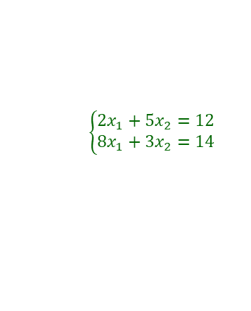
Example
Linear Equation
Write the system of equations in matrix form by using matrix multiplication.
$$\left\{\begin{matrix}2x_{1}+5x_{2}=12 \\ 8x_{1}+3x_{2}=14\end{matrix}\right.$$

Slide 28


Solution
Let
then the single matrix equation is
$$A=\left[\begin{matrix}2 & 5 \\ 8 & 3\end{matrix}\right] x=\left[\begin{matrix}x_{1} \\ x_{2}\end{matrix}\right] b=\left[\begin{matrix}12 \\ 14\end{matrix}\right]$$
$$Ax=b$$
$$\left[\begin{matrix}2 & 5 \\ 8 & 3\end{matrix}\right]\left[\begin{matrix}x_{1} \\ x_{2}\end{matrix}\right]=\left[\begin{matrix}12 \\ 14\end{matrix}\right]$$

Slide 29
Matrix Reduction

Slide 30
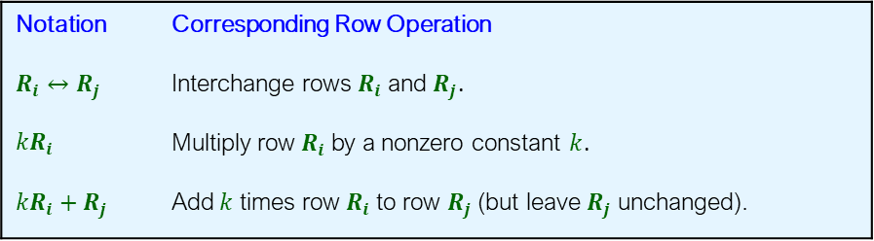
Solving Systems by Reducing Matrices
Elementary Row Operations
Interchanging two rows of a matrix
Multiplying a row of a matrix by a nonzero number
Adding a multiple of one row of a matrix to a different row of that matrix
Notation | Corresponding Row Operation
$$R_{i}↔R_{j}$$ | Interchange rows $R_{i}$ and $R_{j}$.
${kR}_{i}$ | Multiply row $R_{i}$ by a nonzero constant $k$.
$${kR}_{i}+R_{j}$$ | Add $k$ times row $R_{i}$ to row $R_{j}$ (but leave $R_{j}$ unchanged).

Slide 31
Properties of a Reduced Matrix
A matrix is said to be a reduced matrix if all the following are true:
All zero-rows at the bottom.
For each nonzero-row, leading entry is 1 and all other entries in the column of the leading entry are 0.
Leading entry in each row is to the right of the leading entry in any row above it.
Remark:
A leading entry is the first nonzero entry in a nonzero-row
Each matrix is equivalent to a unique reduced matrix.

Slide 32


Example
Reduced Matrices
For each of the following matrices, determine whether it is reduced or not reduced.
$$\text{a}\text{.} \left[\begin{matrix}1 & 0 \\ 0 & 3\end{matrix}\right]$$
$$\text{b}\text{.} \left[\begin{matrix}1 & 0 & 0 \\ 0 & 1 & 0\end{matrix}\right]$$
$$\text{c}\text{.} \left[\begin{matrix}0 & 1 \\ 1 & 0\end{matrix}\right]$$
$$\text{d}\text{.} \left[\begin{matrix}0 & 0 & 0 \\ 0 & 0 & 0\end{matrix}\right]$$
$$\text{e}\text{.} \left[\begin{matrix}1 & 0 & 0 \\ 0 & 0 & 0 \\ 0 & 1 & 0\end{matrix}\right]$$
$$\text{f}\text{.} \left[\begin{matrix}0 & 1 & 0 & 3 \\ 0 & 0 & 1 & 2 \\ 0 & 0 & 0 & 0\end{matrix}\right]$$

Slide 33
Solution
a. Not reduced because the leading entry in the second row is not 1
b. Reduced
c. Not reduced as the leading entry in the second row is not to the right of the leading entry in the first row
d. Reduced
e. Not reduced because the second row, which is a zero-row, is not at the bottom of the matrix
f. Reduced

Slide 34
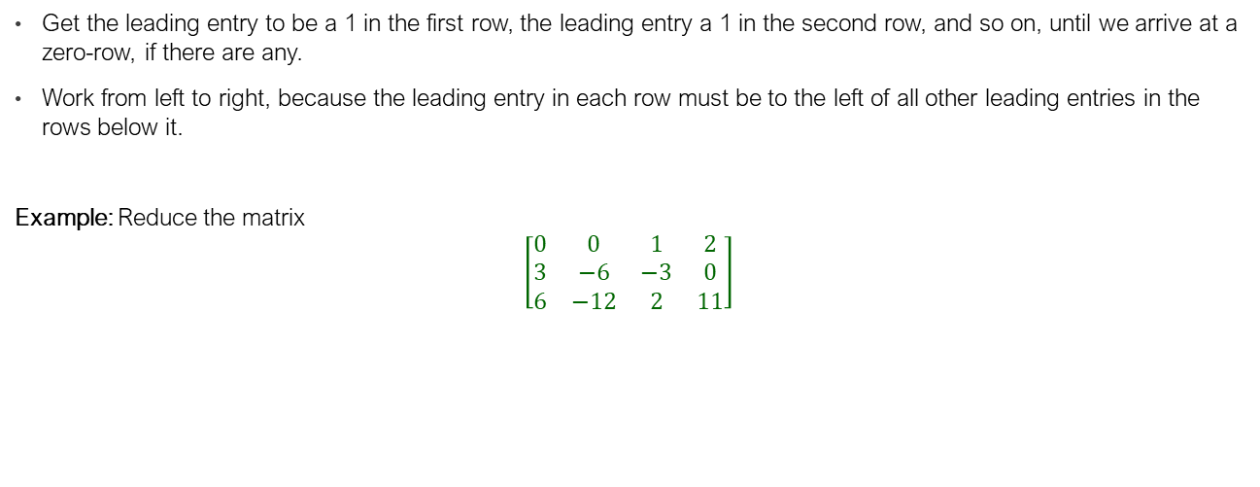
Reducing a Matrix
The Strategy for Reducing a Matrix
Get the leading entry to be a 1 in the first row, the leading entry a 1 in the second row, and so on, until we arrive at a zero-row, if there are any.
Work from left to right, because the leading entry in each row must be to the left of all other leading entries in the rows below it.
Example: Reduce the matrix
$$\left[\begin{matrix}0 & 0 & 1 & 2 \\ 3 & −6 & −3 & 0 \\ 6 & −12 & 2 & 11\end{matrix}\right]$$

Slide 35

Solution
$\left[\begin{matrix}0 & 0 & 1 & 2 \\ 3 & −6 & −3 & 0 \\ 6 & −12 & 2 & 11\end{matrix}\right]\underset{→}{R_{1}↔R_{2}}$ $\left[\begin{matrix}3 & −6 & −3 & 0 \\ 0 & 0 & 1 & 2 \\ 6 & −12 & 2 & 11\end{matrix}\right]$ $\underset{→}{{\frac{1}{3}R}_{1}}$ $\left[\begin{matrix}1 & −2 & −1 & 0 \\ 0 & 0 & 1 & 2 \\ 6 & −12 & 2 & 11\end{matrix}\right]$ $\underset{→}{{−6R}_{1}+R_{3}}$ $\left[\begin{matrix}1 & −2 & −1 & 0 \\ 0 & 0 & 1 & 2 \\ 0 & 0 & 8 & 11\end{matrix}\right]$
$\underset{→}{R_{2}+R_{1}}$ $\left[\begin{matrix}1 & −2 & 0 & 2 \\ 0 & 0 & 1 & 2 \\ 0 & 0 & −4 & 11\end{matrix}\right]$ $\underset{→}{{−8R}_{2}+R_{3}}$ $\left[\begin{matrix}1 & −2 & 0 & 2 \\ 0 & 0 & 1 & 2 \\ 0 & 0 & 0 & −5\end{matrix}\right]$ $\underset{→}{{−\frac{1}{5}R}_{3}}$ $\left[\begin{matrix}1 & −2 & 0 & 2 \\ 0 & 0 & 1 & 2 \\ 0 & 0 & 0 & 1\end{matrix}\right]\underset{→}{{−2R}_{3}+R_{1}} \left[\begin{matrix}1 & −2 & 0 & 0 \\ 0 & 0 & 1 & 2 \\ 0 & 0 & 0 & 1\end{matrix}\right]$
$$\underset{→}{{−2R}_{3}+R_{2}} \left[\begin{matrix}1 & −2 & 0 & 0 \\ 0 & 0 & 1 & 0 \\ 0 & 0 & 0 & 1\end{matrix}\right]$$

Slide 36
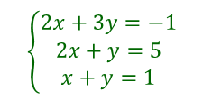
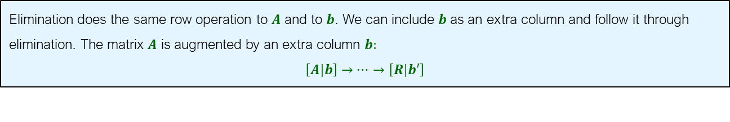
Solving a System by Reduction
Elimination does the same row operation to $A$ and to $b$. We can include $b$ as an extra column and follow it through elimination. The matrix $A$ is augmented by an extra column $b:$
$$\left[A\left|b\right.\right]→⋯→\left[R\left|b′\right.\right]$$
Example: By using matrix reduction, solve the system
$$\left\{\begin{matrix}2x+3y=−1 \\ 2x+y=5 \\ x+y=1\end{matrix}\right.$$

Slide 37
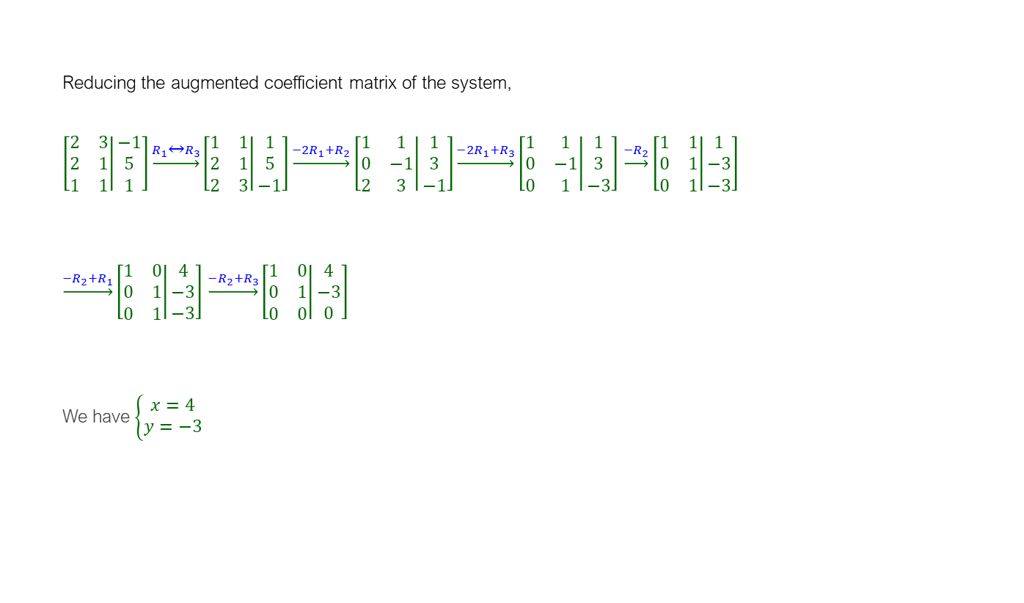
Solution
Reducing the augmented coefficient matrix of the system,
$\left[\left.\begin{matrix}2 & 3 \\ 2 & 1 \\ 1 & 1\end{matrix}\right|\begin{matrix}−1 \\ 5 \\ 1\end{matrix}\right]\underset{→}{R_{1}↔R_{3}}\left[\left.\begin{matrix}1 & 1 \\ 2 & 1 \\ 2 & 3\end{matrix}\right|\begin{matrix}1 \\ 5 \\ −1\end{matrix}\right]\underset{→}{{−2R}_{1}+R_{2}}\left[\left.\begin{matrix}1 & 1 \\ 0 & −1 \\ 2 & 3\end{matrix}\right|\begin{matrix}1 \\ 3 \\ −1\end{matrix}\right]\underset{→}{{−2R}_{1}+R_{3}}\left[\left.\begin{matrix}1 & 1 \\ 0 & −1 \\ 0 & 1\end{matrix}\right|\begin{matrix}1 \\ 3 \\ −3\end{matrix}\right]$ $\underset{→}{{−R}_{2}}\left[\left.\begin{matrix}1 & 1 \\ 0 & 1 \\ 0 & 1\end{matrix}\right|\begin{matrix}1 \\ −3 \\ −3\end{matrix}\right]$
$\underset{→}{{−R}_{2}+R_{1}}\left[\left.\begin{matrix}1 & 0 \\ 0 & 1 \\ 0 & 1\end{matrix}\right|\begin{matrix}4 \\ −3 \\ −3\end{matrix}\right]$ $\underset{→}{{−R}_{2}+R_{3}}\left[\left.\begin{matrix}1 & 0 \\ 0 & 1 \\ 0 & 0\end{matrix}\right|\begin{matrix}4 \\ −3 \\ 0\end{matrix}\right]$
We have $\left\{\begin{matrix}x=4 \\ y=−3\end{matrix}\right.$

Slide 38
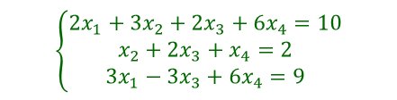
Example
Parametric Form of a Solution
$$\left\{\begin{matrix}2x_{1}+3x_{2}+2x_{3}+6x_{4}=10 \\ x_{2}+2x_{3}+x_{4}=2 \\ 3x_{1}−3x_{3}+6x_{4}=9\end{matrix}\right.$$
Using matrix reduction, solve

Slide 39
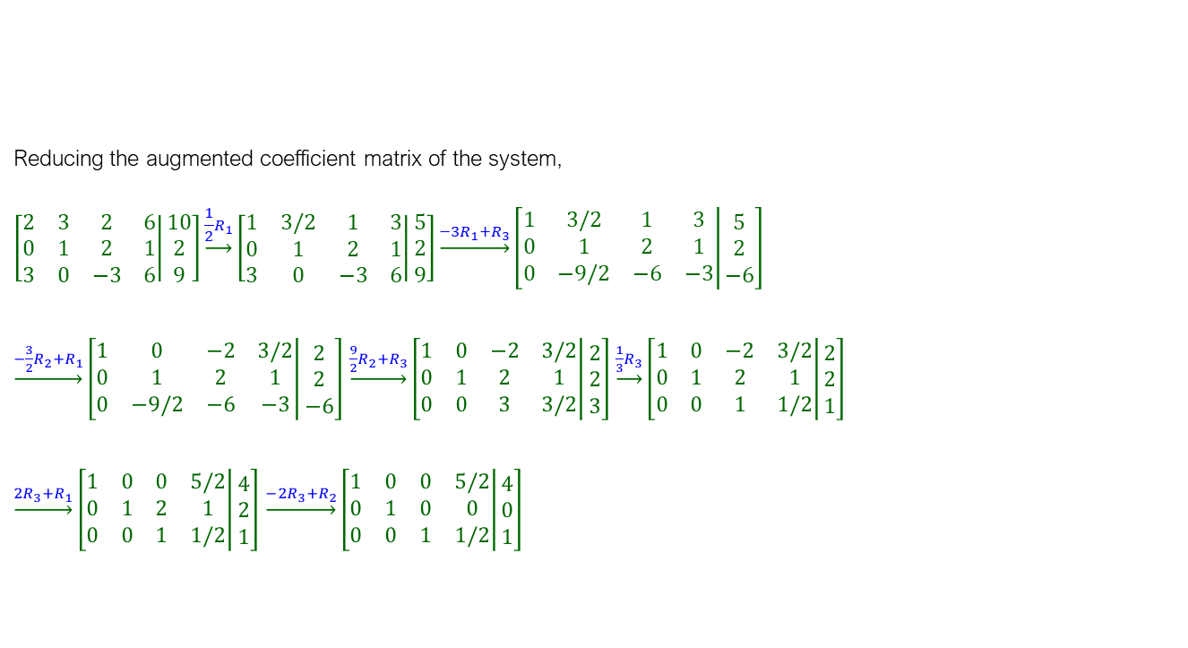
Solution
Reducing the augmented coefficient matrix of the system,
$$\left[\left.\begin{matrix}2 & 3 & 2 & 6 \\ 0 & 1 & 2 & 1 \\ 3 & 0 & −3 & 6\end{matrix}\right|\begin{matrix}10 \\ 2 \\ 9\end{matrix}\right]\underset{→}{{\frac{1}{2}R}_{1}}\left[\left.\begin{matrix}1 & 3/2 & 1 & 3 \\ 0 & 1 & 2 & 1 \\ 3 & 0 & −3 & 6\end{matrix}\right|\begin{matrix}5 \\ 2 \\ 9\end{matrix}\right]\underset{→}{{−3R}_{1}+R_{3}}\left[\left.\begin{matrix}1 & 3/2 & 1 & 3 \\ 0 & 1 & 2 & 1 \\ 0 & −9/2 & −6 & −3\end{matrix}\right|\begin{matrix}5 \\ 2 \\ −6\end{matrix}\right]$$
$\underset{→}{{−\frac{3}{2}R}_{2}+R_{1}}\left[\left.\begin{matrix}1 & 0 & −2 & 3/2 \\ 0 & 1 & 2 & 1 \\ 0 & −9/2 & −6 & −3\end{matrix}\right|\begin{matrix}2 \\ 2 \\ −6\end{matrix}\right]$ $\underset{→}{{\frac{9}{2}R}_{2}+R_{3}}\left[\left.\begin{matrix}1 & 0 & −2 & 3/2 \\ 0 & 1 & 2 & 1 \\ 0 & 0 & 3 & 3/2\end{matrix}\right|\begin{matrix}2 \\ 2 \\ 3\end{matrix}\right]$ $\underset{→}{\frac{1}{3}R_{3}}\left[\left.\begin{matrix}1 & 0 & −2 & 3/2 \\ 0 & 1 & 2 & 1 \\ 0 & 0 & 1 & 1/2\end{matrix}\right|\begin{matrix}2 \\ 2 \\ 1\end{matrix}\right]$
$\underset{→}{{2R}_{3}+R_{1}}\left[\left.\begin{matrix}1 & 0 & 0 & 5/2 \\ 0 & 1 & 2 & 1 \\ 0 & 0 & 1 & 1/2\end{matrix}\right|\begin{matrix}4 \\ 2 \\ 1\end{matrix}\right]$ $\underset{→}{{−2R}_{3}+R_{2}}\left[\left.\begin{matrix}1 & 0 & 0 & 5/2 \\ 0 & 1 & 0 & 0 \\ 0 & 0 & 1 & 1/2\end{matrix}\right|\begin{matrix}4 \\ 0 \\ 1\end{matrix}\right]$

Slide 40

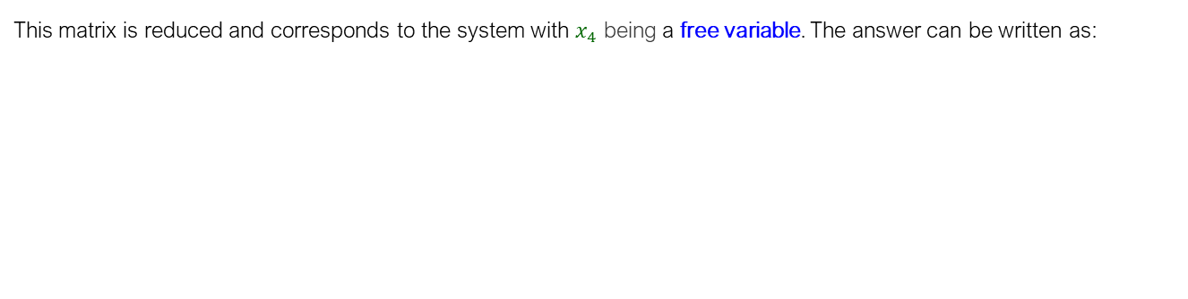
Solution (cont’d)
This matrix is reduced and corresponds to the system with $x_{4}$ being a free variable. The answer can be written as:
$$\left\{\begin{matrix}x_{1}+\frac{5}{2}x_{4}=4 \\ x_{2}=0 \\ x_{3}+\frac{1}{2}x_{4}=1\end{matrix}⇒x=\left[\begin{aligned}4 \\ 0 \\ 1 \\ 0\end{aligned}\right]+x_{4}\left[\begin{aligned}−\frac{5}{2} \\ 0 \\ −\frac{1}{2} \\ 1\end{aligned}\right]\right.$$
Definition: The variables whose columns do not have a leading entry are called free variables. The variables whose columns have a leading entry are called pivot variables.

Slide 41
Matrix Inverse

Slide 42
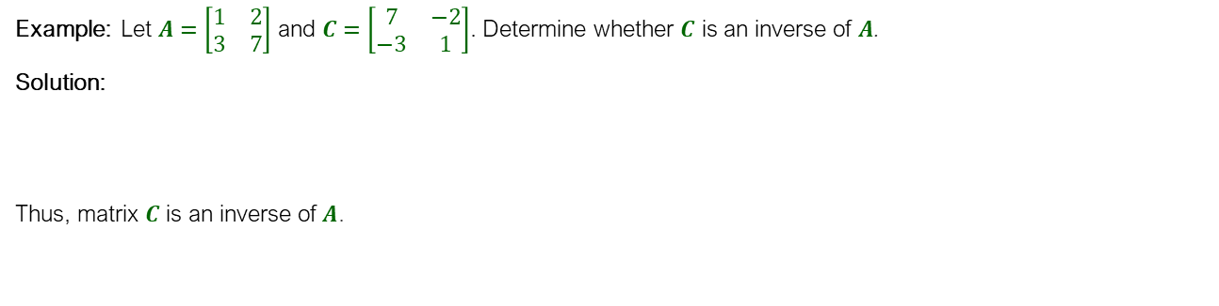
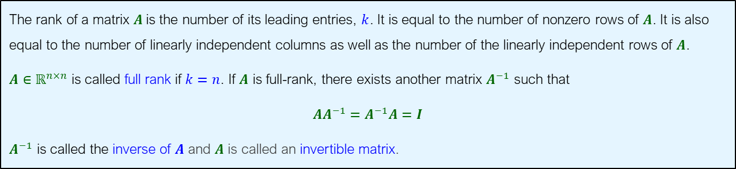

Inverses
The rank of a matrix $A$is the number of its leading entries, $k$. It is equal to the number of nonzero rows of $A$. It is also equal to the number of linearly independent columns as well as the number of the linearly independent rows of $A$.
$A∈ℝ^{n×n}$ is called full rank if $k=n$. If $A$ is full-rank, there exists another matrix $A^{−1}$ such that
$AA^{−1}=A^{−1}A=I$
$A^{−1}$ is called the inverse of $A$ and $A$ is called an invertible matrix.
Example: Let $A=\left[\begin{matrix}1 & 2 \\ 3 & 7\end{matrix}\right]$ and $C=\left[\begin{matrix}7 & −2 \\ −3 & 1\end{matrix}\right]$. Determine whether $C$ is an inverse of $A$.
Solution:
Thus, matrix $C$ is an inverse of $A$.
$$CA=\left[\begin{matrix}7 & −2 \\ −3 & 1\end{matrix}\right]\left[\begin{matrix}1 & 2 \\ 3 & 7\end{matrix}\right]=\left[\begin{matrix}1 & 0 \\ 0 & 1\end{matrix}\right]=I$$

Slide 43
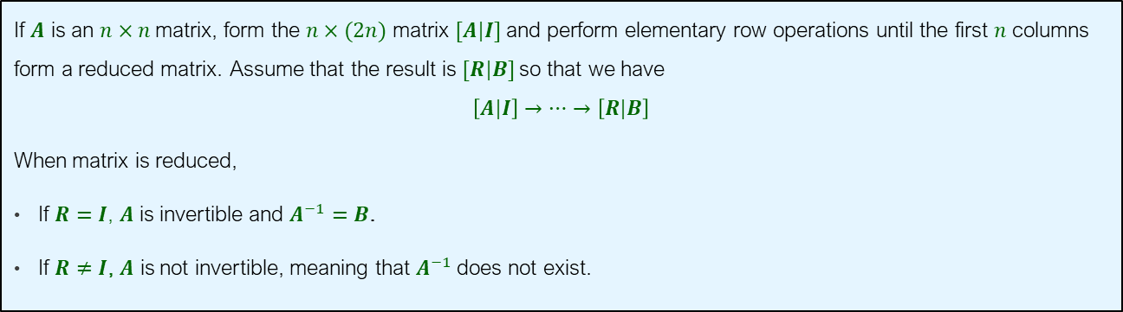
Method to Find the Inverse of a Matrix
If $A$ is an $n×n$matrix, form the $n×(2n)$ matrix $[A|I]$and perform elementary row operations until the first $n$ columns form a reduced matrix. Assume that the result is $[R|B]$so that we have
$$\left[A\left|I\right.\right]→⋯→\left[R\left|B\right.\right]$$
When matrix is reduced,
If $R=I$, $A$ is invertible and $A^{−1}=B$.
If $R≠I$, $A$ is not invertible, meaning that $A^{−1}$does not exist.
Remark: To determine the inverse matrix in R you can use solve(A)

Slide 44

Example
Finding The Inverse by Reducing
Find the inverse of $A=\left[\begin{matrix}1 & 0 \\ 2 & 2\end{matrix}\right]$ if it exists.

Slide 45
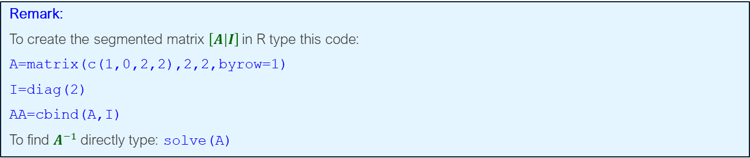
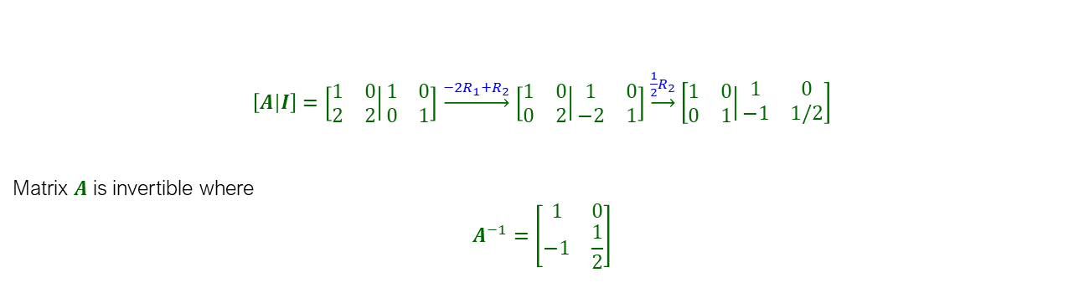
Solution
$\left[A\left|I\right.\right]=\left[\left.\begin{matrix}1 & 0 \\ 2 & 2\end{matrix}\right|\begin{matrix}1 & 0 \\ 0 & 1\end{matrix}\right]$ $\underset{→}{{−2R}_{1}+R_{2}}$ $\left[\left.\begin{matrix}1 & 0 \\ 0 & 2\end{matrix}\right|\begin{matrix}1 & 0 \\ −2 & 1\end{matrix}\right]$ $\underset{→}{\frac{1}{2}R_{2}}$ $\left[\left.\begin{matrix}1 & 0 \\ 0 & 1\end{matrix}\right|\begin{matrix}1 & 0 \\ −1 & 1/2\end{matrix}\right]$
Matrix $A$ is invertible where
$$A^{−1}=\left[\begin{matrix}1 & 0 \\ −1 & \frac{1}{2}\end{matrix}\right]$$
Remark:
To create the segmented matrix $\left[A\left|I\right.\right]$in R type this code:
A=matrix(c(1,0,2,2),2,2,byrow=1)
I=diag(2)
AA=cbind(A,I)
To find $A^{−1}$directly type: solve(A)

Slide 46
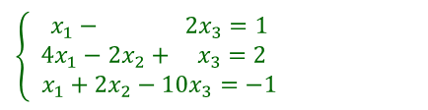
Example 5
Using the Inverse to Solve a System
Solve the system by finding the inverse of the coefficient matrix.
$$\left\{\begin{matrix} x_{1}− 2x_{3}=1 \\ 4x_{1}−2x_{2}+ x_{3}=2 \\ x_{1}+2x_{2}−10x_{3}=−1\end{matrix}\right.$$

Slide 47


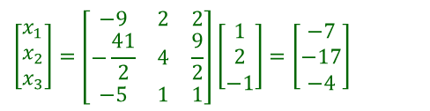

Solution
We have
For inverse,
The solution is given by $x=A^{−1}B$:
$$A=\left[\begin{matrix}1 & 0 & −2 \\ 4 & −2 & 1 \\ 1 & 2 & −10\end{matrix}\right]$$
$$A^{−1}=\left[−\begin{matrix}−9 & 2 & 2 \\ \frac{41}{2} & 4 & \frac{9}{2} \\ −5 & 1 & 1\end{matrix}\right]$$
$$\left[\begin{matrix}x_{1} \\ x_{2} \\ x_{3}\end{matrix}\right]=\left[\begin{matrix}−9 & 2 & 2 \\ −\frac{41}{2} & 4 & \frac{9}{2} \\ −5 & 1 & 1\end{matrix}\right]\left[\begin{matrix}1 \\ 2 \\ −1\end{matrix}\right]=\left[\begin{matrix}−7 \\ −17 \\ −4\end{matrix}\right]$$
Remark: To find the solution $x=A^{−1}B$ in R use: solve(A,b)

